Slide 1
LCPC Training
Brief Start

Slide 2
What we’re going to do
Bitwise operations (included in 2 questions)
String manipulation (see modify_strings.cpp)
Explaining the 1st lcpc question

Slide 3
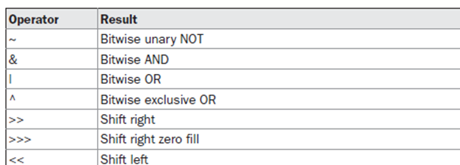
Bit wise operations

